Slide 1
Microservices and DevOps
Scalable Microservices
Docker Security
Henrik Bærbak Christensen

Slide 2
Introduction
Sources:
  Newman §9
    Some aspects has already been covered
  Snyk.io / Vermeer
    A few aspects have been covered
  Docker secrets
    Find it on Docker website

Slide 3
Security in Transit
Security in transit
  Use TLS to ensure encrypted (at least outwards) traffic
  Use Authentication and Authorization
    Like OAuth 2.0
  Deputy problem is relevant in a MicroService context:
    Cmd calls Daemon calls CaveService
      But cmd is only authorized against Daemon?
  Solution: OAuth 2.0 provides the /introspect feature
    Daemon hands bearer token to CaveService
    CaveService can then /introspect validity on the AuthServer
      And thus establish trust without trusting Daemon

Slide 4
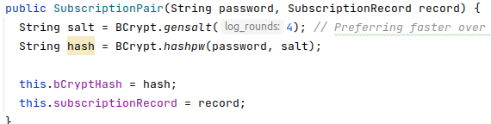
Security at Rest
Encrypt the databases…
  For Redis, it seems it relies on encrypted file systems !
    I.e. no direct support by the Redis DB itself
      As far as I can dig out of the documentation
  Do not invent encryption algorithms yourself ☺
    Use existing tools and algorithms
    Use BitLocker, etc.
  For passwords, store them using salted password hashing
    Actually the jCrypt (BCrypt implementation) is used even in the Stub subscription service

Slide 5
Defense in Depth
Firewalls
  Only allow network traffic on proper ports
    i.e. no “ports 6379” on your Redis in the swarm
    It is already accessible from with the swarm but now you expose it to the outside!
  Beware of issuing ‘docker run –p 6379:6379…’ on a production machine
    Docker will open the port using IPTABLES and ‘ufw’ does not see it!

Slide 6
Defense in Depth
Logging
  Proper logging allows detecting and recovering from attacks
  Do not store sensitive information in logs
    As the skycave daemon does at the moment!
Intrusion Detection Systems
  IPS can help out
    I have no personal experience ☹

Slide 7
Defense in Depth
Network Segregation
  Separate nodes onto separate networks
  I.e. a ‘frontend-network’ for the API Gateway
  And a ‘backend-network’ for the internal services + databases
Swarm is excellent at this
  You can attach a service on multiple networks
    API gateway on both frontend and backend
DigitalOcean et al.
  Provides ‘private network’
    Use that network for Cluster communication, not the official IP address

Slide 8
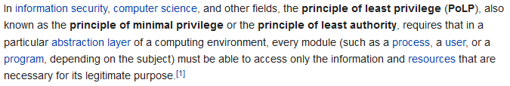
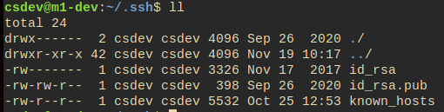
Not mentioned?
Principle of least privilege (Source: Wikipedia)
In Linux
  Control your ‘umask’
  Ensure only you can read/write sensitive files
  Don’t be the
  root user
  Etc.

Slide 9
Key Management
Docker Swarm has excellent secure key management
  Usernames and passwords
  TLS certificates and keys
  Database passwords, etc
Only works in stacks – not in standalone containers
Idea
  docker secret create thesecret hostfile
    Will
      Encrypt local ‘hostfile’
      Send it to all nodes in swarm using TLS
      Make file available in /run/secrets/thesecret
  Passwords are a bit weird, as secrets are files…

Slide 10
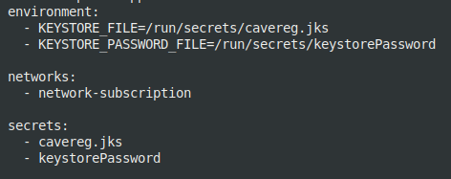

Docker Secret
Snippet from Subscription Service’s compose file
And creating the secrets on the swarm manager
  i.e. you have to fiddle with the server to set the passwords
    Fair enough, but well manual process

Slide 11
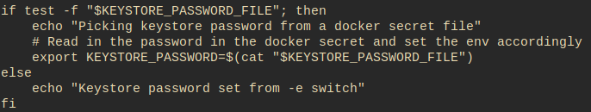
Reading ‘passwords’
As all secrets are files – what to do with a password?
  You have to fiddle with a ENTRYPOINT script

Slide 12
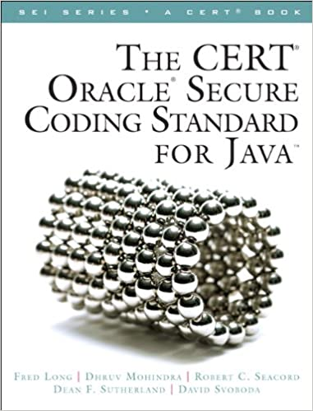
Vulnerabilities
All code can contain loopholes that attackers can use
  Code vulnerabilities
Writing secure (Java) code…
  Is a major topic on its own
    And way outside scope of course and
    my area of expertise…
Ensure you do not import other’s vulnerabilities
  I.e. ensuring your container is as secure as possible

Slide 13
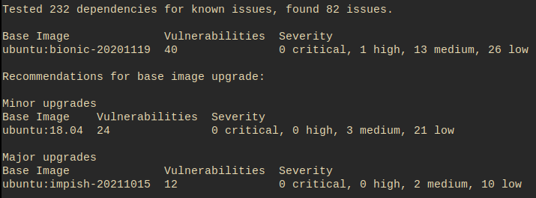
Snyk.io
You can scan your image for vulnerabilities
☹

Slide 14
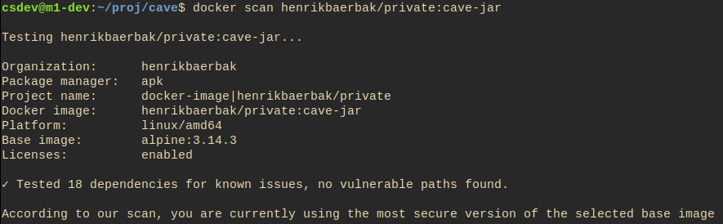
Vermeer (2021)
Vermeer provide a set of practices to use in creating images, which lowers the amount of vulnerabilities.
I tried them and got ☺ this…

Slide 15
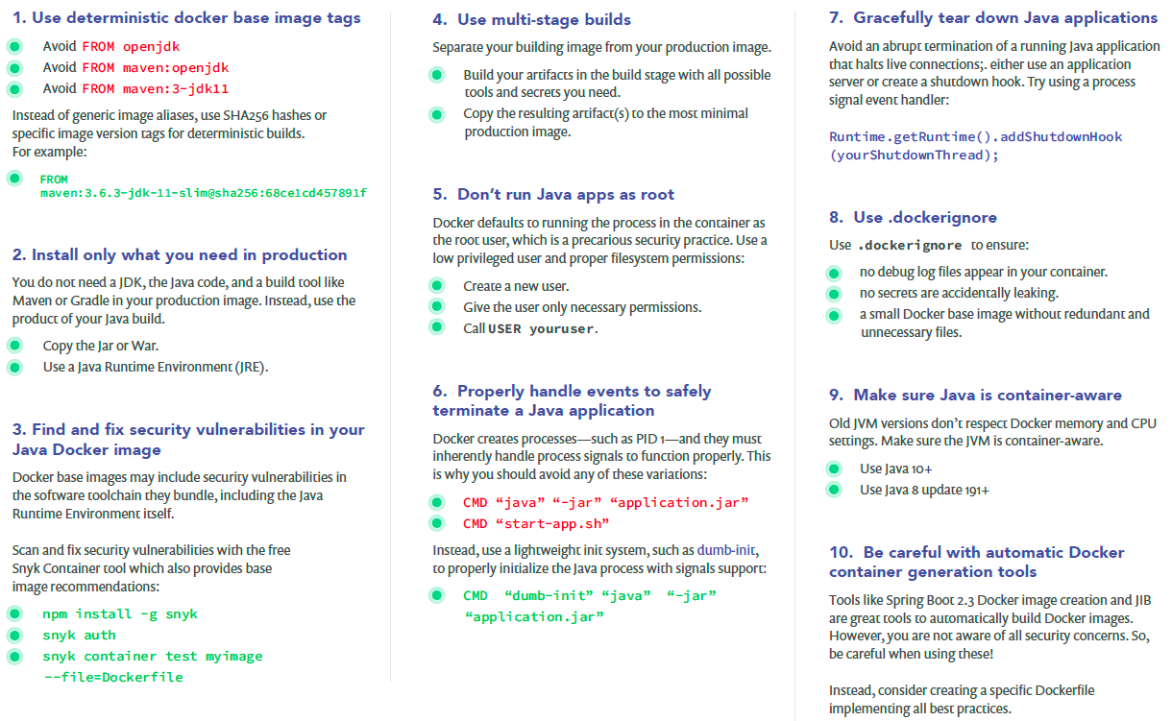
Advice in short form
Source: 10 best practices to containerize Java applications with Docker

Slide 16
Summary
Lots of attack surfaces ☹
  Lots of place in which you must do the right thing and adhere to the right protocols and practices

